Slide 1
微處理機系統 &微處理機系統實習

Slide 2
#define GPIO_MODE_INPUT 0x0UL /*!< Input Mode */
#define GPIO_MODE_OUTPUT 0x1UL /*!< Output Mode */
#define GPIO_MODE_QUASI 0x3UL /*!< Quasi-bidirectional Mode */

Slide 3
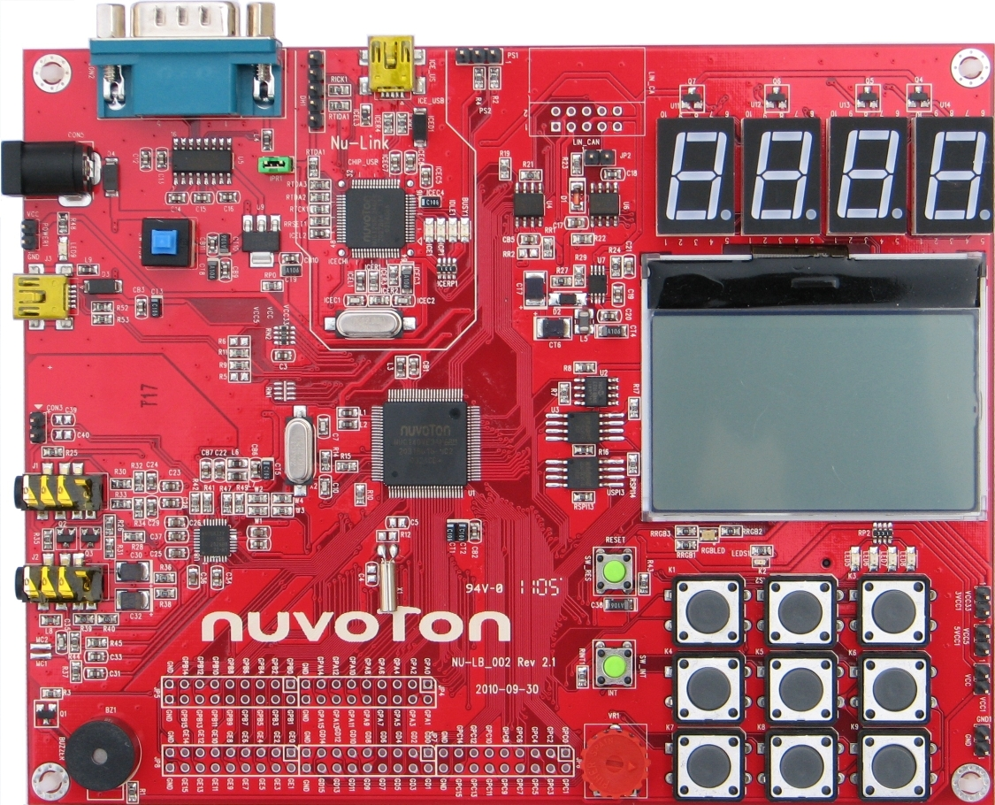
keypad?

Slide 4
led?

Slide 5
transmit?
receive?

Slide 7
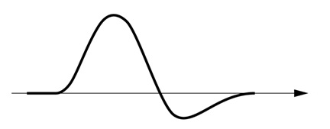
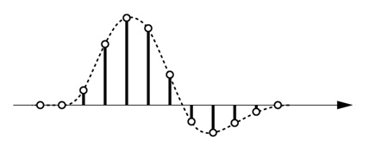
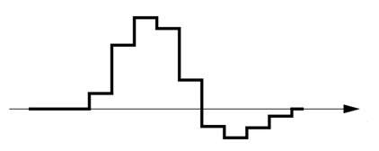
Signal Conversion
ADC
DAC
Filter

Slide 8
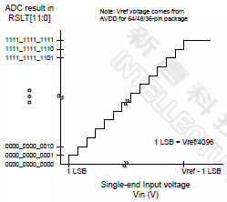
Signal Conversion

Slide 9
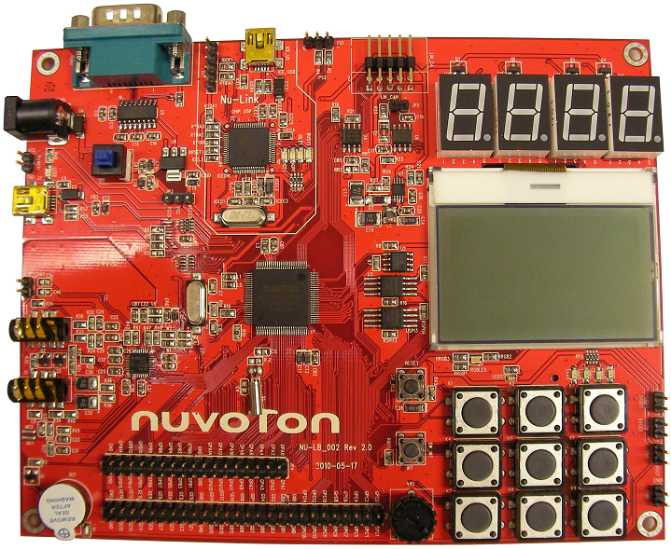
Signal Conversion
Learning Board ADC reference voltage is 3.3V
ADC0~7(GPA0~7)
VR1

Slide 10
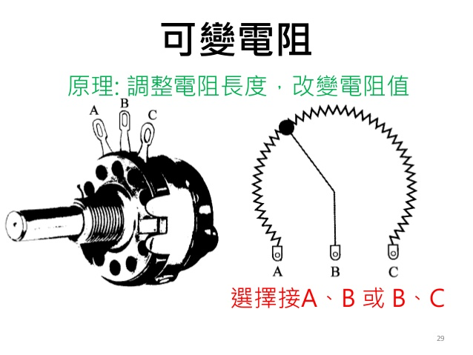
Signal Conversion

Slide 11
https://youtu.be/6wKEMwY5_Rw

Slide 12
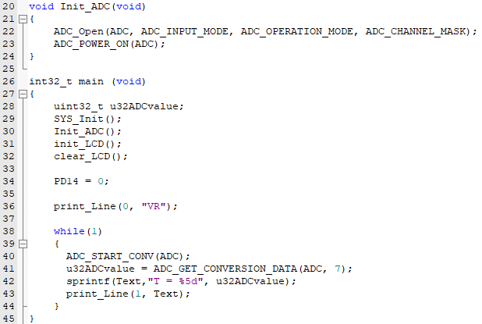

Slide 13
實作說明：
利用七段顯示器，依序顯示0000, 0001, 0002,…… ,9999, 0000, 0001
試著使用VR(Variable Resistor)來調整亮度

Slide 14


